Slide 1

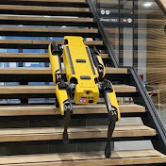
Offline RL, introduction, methods, and challenges
Mohammadreza Nakhaei
Aalto Robot Learning Lab
November 2023

Slide 2
Introduction

Slide 3
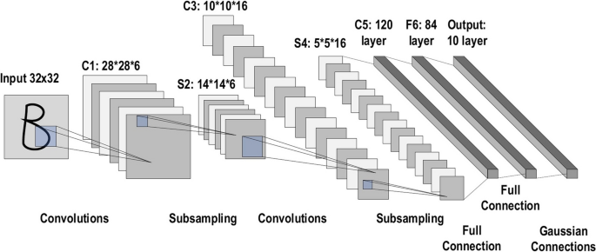
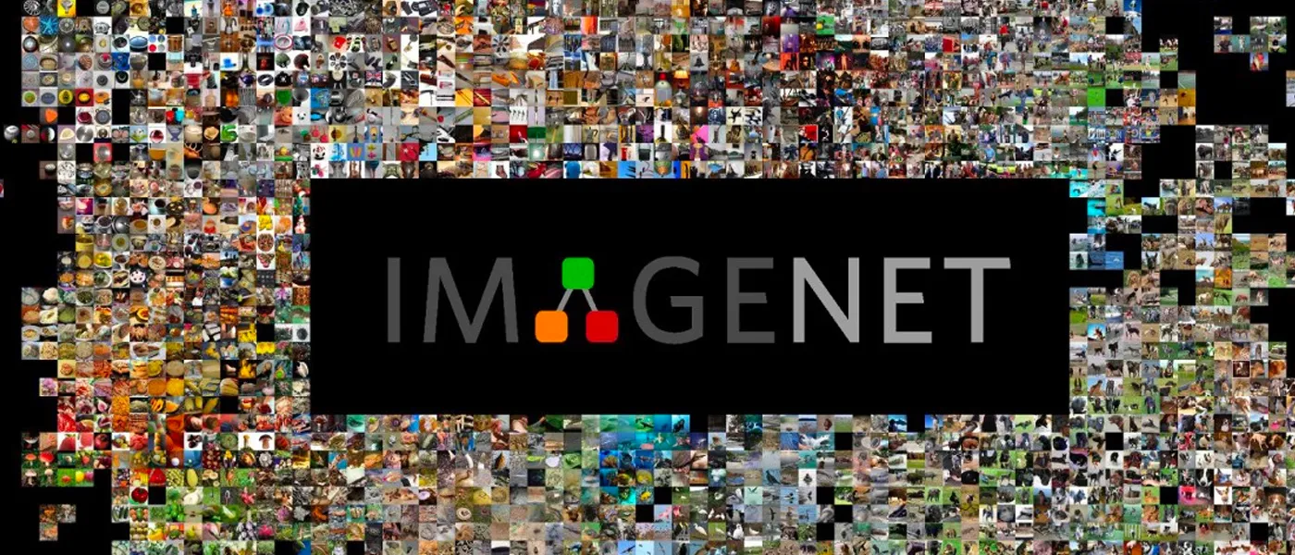
Motivation
Success of Modern ML
Challenges with Online RL:
Active data collection: expensive, unsafe, unethical, …
Not perfect simulator, require sim-real transfer
Alzubaidi, L., Zhang, J., Humaidi, A.J. et al. (2021), Review of deep learning: concepts, CNN architectures, challenges, applications, future directions. J Big Data
Deng, J., Dong, W., Socher, R., Li, L.-J., Li, K., & Fei-Fei, L. (2009). Imagenet: A large-scale hierarchical image database. In 2009 IEEE conference on computer vision and pattern recognition

Slide 4
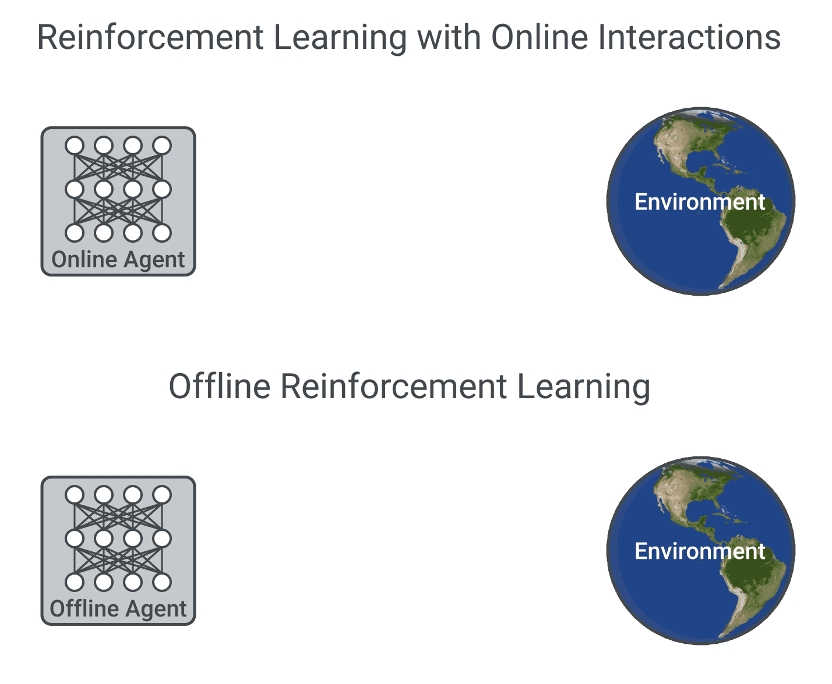
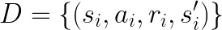
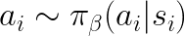
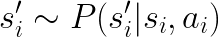
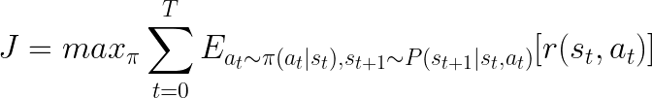
What is Offline RL?
Formally:
Objective:
Under fixed, Static Dataset
Usually Not Known
Agarwal, R., Schuurmans, D. & Norouzi, M.. (2020). An Optimistic Perspective on Offline Reinforcement Learning, ICML

Slide 5
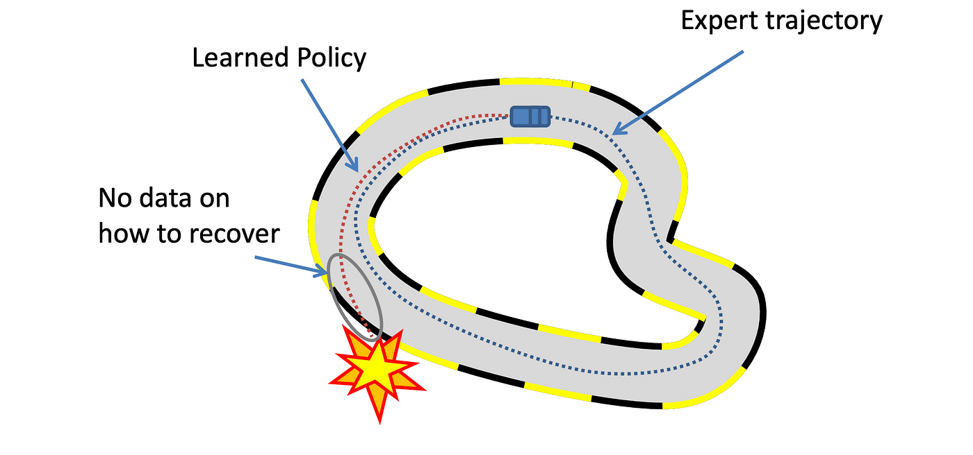
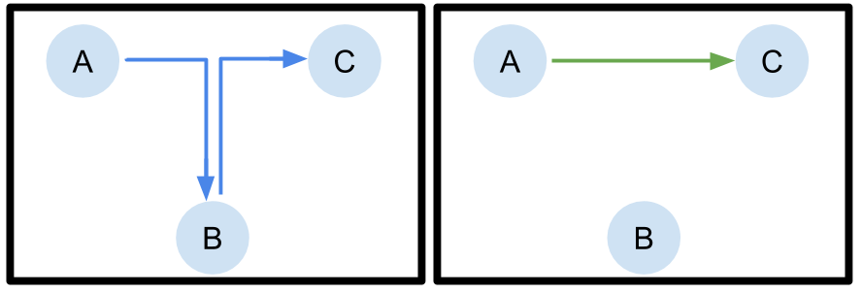
Offline RL vs Imitation Learning?
Offline RL
Reward function
Sub-optimal noisy demonstrations
Stitching good behaviors!
Large datasets
Imitation Learning
No reward label
Expert demonstrations
Mimic the expert
Require less data
Kumar, A. & Levine, S.. (2020). Offline Reinforcement Learning: From Algorithms to Practical Challenges, NeurIPS 2020 Tutorial
Chen, L., Wu, P., Chitta, K., Jaeger, B., Geiger, A., & Li, H. (2023). End-to-end autonomous driving: Challenges and frontiers

Slide 6
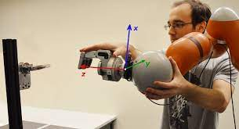
Benefit of Offline RL
Learning from existing logged data
Human operators
Hand design controllers/systems
RL agents
Mixtures of sources
Data could be shared!
Dataset from different task can also be used (reward relabelling)
Racca, Mattia, et al. (2016) "Learning in-contact control strategies from demonstration." IROS.
Pretraining and fine tuning with RL
More sample-efficient than training RL from scratch!
Guiding the agent, less exploratory/dangerous behavior

Slide 7
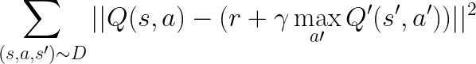
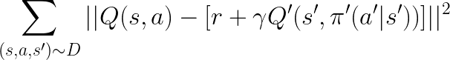

Standard Off-policy RL?
Recall: Q-Learning objective:
What could be the problem?
What if is not in the dataset?
Bootstrapping: Learning from a guess!
Max operator: select actions with overestimated Q value
Distribution shift: Learned policy deviates from behavior policy, reaching unfamiliar states!
Agarwal, R., Schuurmans, D. & Norouzi, M.. (2020). An Optimistic Perspective on Offline Reinforcement Learning, International Conference on Machine Learning (ICML).

Slide 8
Methods

Slide 9
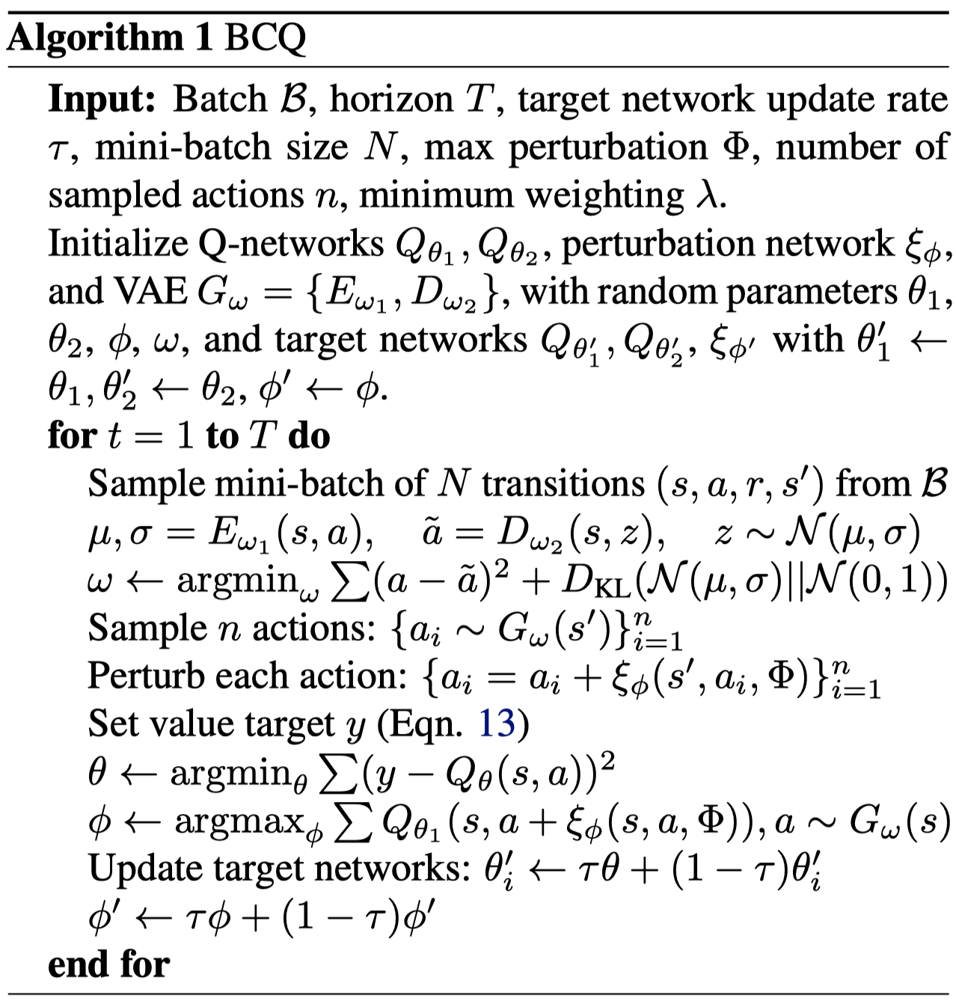
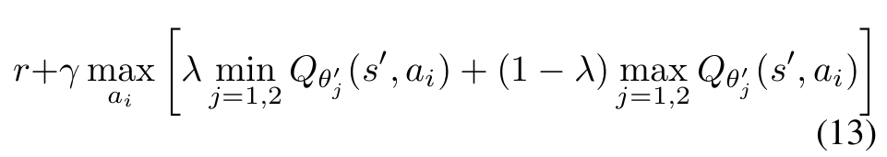
Batch Constraints Deep Q Learning (BCQ)
OOD
Recall: Q-Learning objective:
Constraining the action by conditional generative model
VAE propose n actions conditions on state (close to behavior policy)
Evaluate potentials actions with added constrained perturbations (increase diversity)
Weighted double clipped Q functions:
Fujimoto, S., Meger, D., & Precup, D. (2019). Off-policy deep reinforcement learning without exploration. ICML

Slide 10
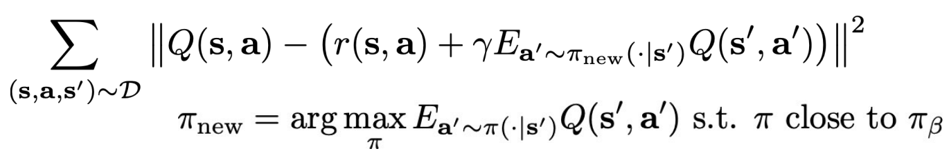
Behavior Regularized Actor Critic (BRAC)
New objective:
Not known
Direct method
Learn behavior policy in imitation learning style (fit behavior policy)
Use direct distance functions such as KL divergence, Wasserstein
Easier to implement
Implicit:
Support constraints:
Usually use maximum mean discrepancy (MMD) kernel
Wu, Y., Tucker, G., & Nachum, O. (2019). Behavior Regularized Offline Reinforcement Learning.

Slide 11
Behavior Regularized Actor Critic (BRAC)
Especial case: KL Divergence and Gaussian distributions
Output of the policy and behavior policy are Gaussian
Objective:
Another way:
Lagrange Multiplier
Wu, Y., Tucker, G., & Nachum, O. (2019). Behavior Regularized Offline Reinforcement Learning.

Slide 12
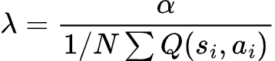
TD3-BC
TD3 compared To DDPG
Two critics, take the min for the target value
Add noise to the actions selected for the target value
Update actor less often than critic
TD3-BC for offline RL
Directly encouraging policy to select actions close to behavior policy
Normalizing the Q values
Fujimoto, S., & Gu, S. S. (2021). A minimalist approach to offline reinforcement learning. NeurIPS.

Slide 13
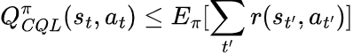
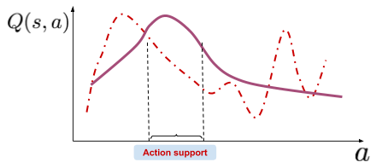
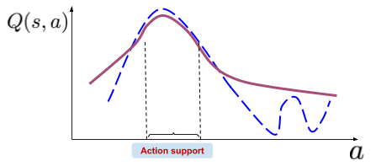
Conservative Q Learning (CQL)
Learn a Q-function, that lower-bounds the policy value, provably
Actual Q-function
Learned Q
CQL Q-function
Uniform random actions
From dataset
Bellman Operator
Similar to SAC
Kumar, A., Zhou, A., Tucker, G., & Levine, S. (2020). Conservative q-learning for offline reinforcement learning.. NeurIPS.

Slide 14
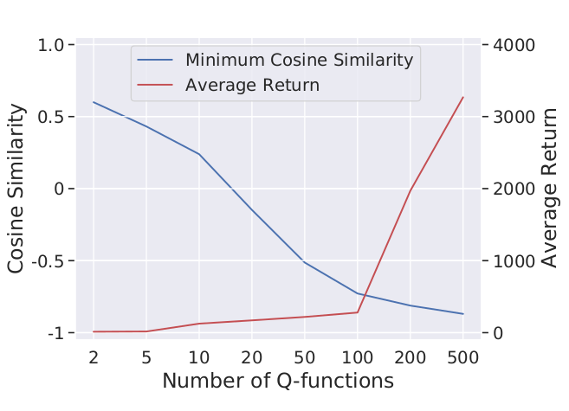
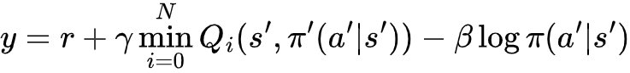
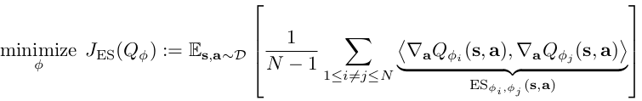
Ensemble-Diversified Actor Critic (EDAC)
Instead of one/two critics, consider N ensemble of them
Take the minimum value for computing the target (SAC-N)
Generally require large number of critics (up to 500).
EDAC: Diversify the critics local structure
Diversify the gradient of the critic with respect to the actions
Reduce the number of critic for the same performance
An, G., Moon, S., Kim, J. H., & Song, H. O. (2021). Uncertainty-based offline reinforcement learning with diversified q-ensemble. NeurIPS

Slide 15
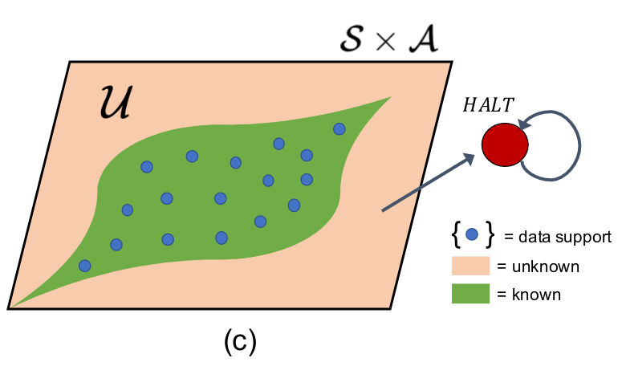
Model-based methods based on Uncertainty
Estimate transition dynamics (and reward function) from dataset.
Apply RL methods in the learned dynamics
Online transitions, no distribution shift
Problem: Dynamic model estimation is not accurate due to limited data
Uncertainty Quantification (could be hard).
Ensemble of probabilistic networks
Penalizing reward (MOPO):
Large negative reward for unknown region (MOREL)
Yu, T., Thomas, G., Yu, L., Ermon, S., Zou, J. Y., Levine, S., ... & Ma, T. (2020). Mopo: Model-based offline policy optimization. NeurIPS.
Kidambi, R., Rajeswaran, A., Netrapalli, P., & Joachims, T. (2020). Morel: Model-based offline reinforcement learning, NeurIPS

Slide 16
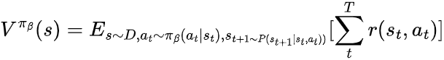
Advantage Weighted Regression (AWR)
Idea: Imitation learning weighted by advantage function
Learn value function for the behavior policy:
Learn policy:
Hyper-parameter
Empirical Return
Advantages
No OOD action selection
Easy to implement
Disadvantages
Monte carlo estimates are noisy (high variance)
Multi-modality in dataset
Peng, X. B., Kumar, A., Zhang, G., & Levine, S. (2020). Advantage-Weighted Regression: Simple and Scalable Off-Policy Reinforcement Learning.

Slide 17
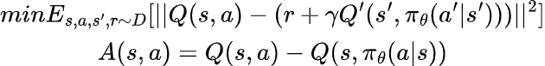
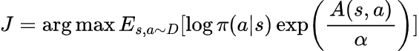
Advantage Weighted Actor Critic (AWAC)
Idea: Using Actor Critic to learn advantage instead of Monte Carlo samples (Bootstrapping)
Learn Q function according to the policy:
Learn policy:
Advantages
Policy trained on actions in dataset
Better advantage estimation
Disadvantages
OOD actions in advantages
Multi-modality
Implicit Q Learning (IQL): Extension of AWAC; Sarsa style value function learning with expectile regression Loss
Nair, A., Gupta, A., Dalal, M., & Levine, S. (2020). Awac: Accelerating online reinforcement learning with offline datasets.

Slide 18
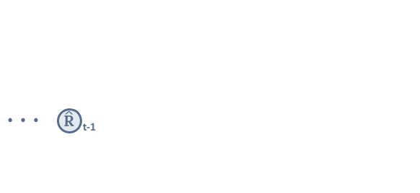
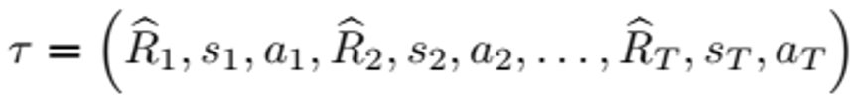
Decision Transformer
Idea: Viewing Offline RL as Big sequence
Predict action condition on a sequence of previous states, actions, and desired returns.
Transformer architecture (similar to GPT-2, but smaller)
Chen, L., Lu, K., Rajeswaran, A., Lee, K., Grover, A., Laskin, M., ... & Mordatch, I. (2021). Decision transformer: Reinforcement learning via sequence modeling, NeurIPS

Slide 19


Trajectory Transformer
Idea: Modeling the environment with transformer
Trajectory Transformer
Maximizing log-likelihood of sequences
Generative multiple possible sequences
Plan with beam search algorithm
Select the best action
Discretized states and actions
One step MLP Model
Janner, M., Li, Q., & Levine, S. (2021). Offline reinforcement learning as one big sequence modeling problem. NeurIPS

Slide 20
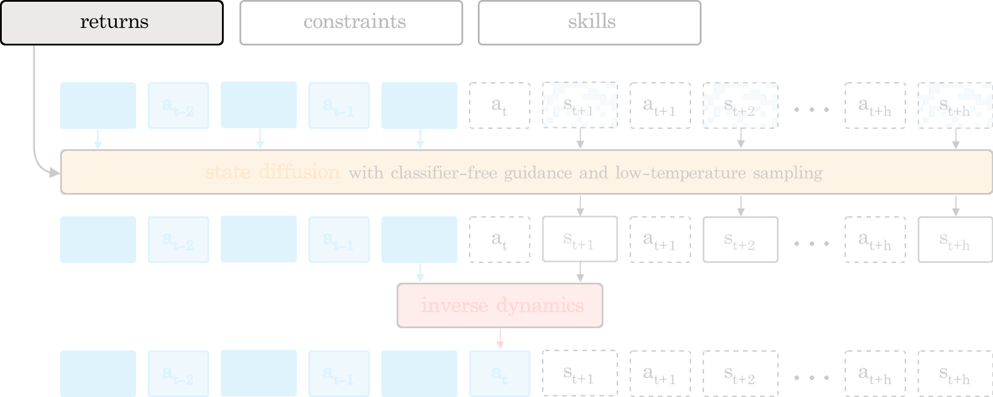
Decision Diffusion
Idea: Generating sequence of states using diffusion models.
Could be conditioned on Returns, constraints and skills
U-Net architecture with 1d convolutions
Ajay, A., Du, Y., Gupta, A., Tenenbaum, J., Jaakkola, T., & Agrawal, P. (2023). Is conditional generative modeling all you need for decision-making, ICLR

Slide 21
Challenges

Slide 22
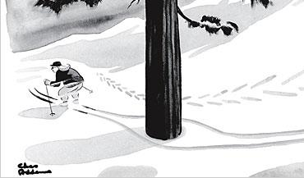
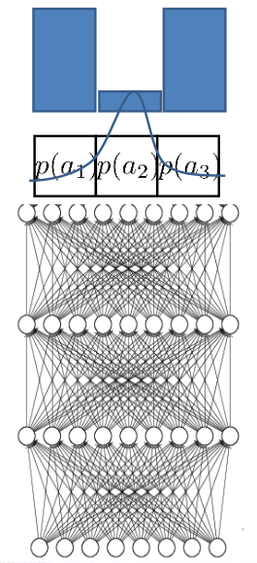
Multi-modal Behavior In Dataset
Different actions (solutions)
Data collected from various sources
More expressive distributions
Mixture of Gaussian
Latent variable model (VAE)
Diffusion models
Discretization of actions
In high-dimensions, almost impractical
Which Offline RL algorithms suffer from this?
Pictures adopted from Sergey Levine, Deep RL course at Berkeley

Slide 23
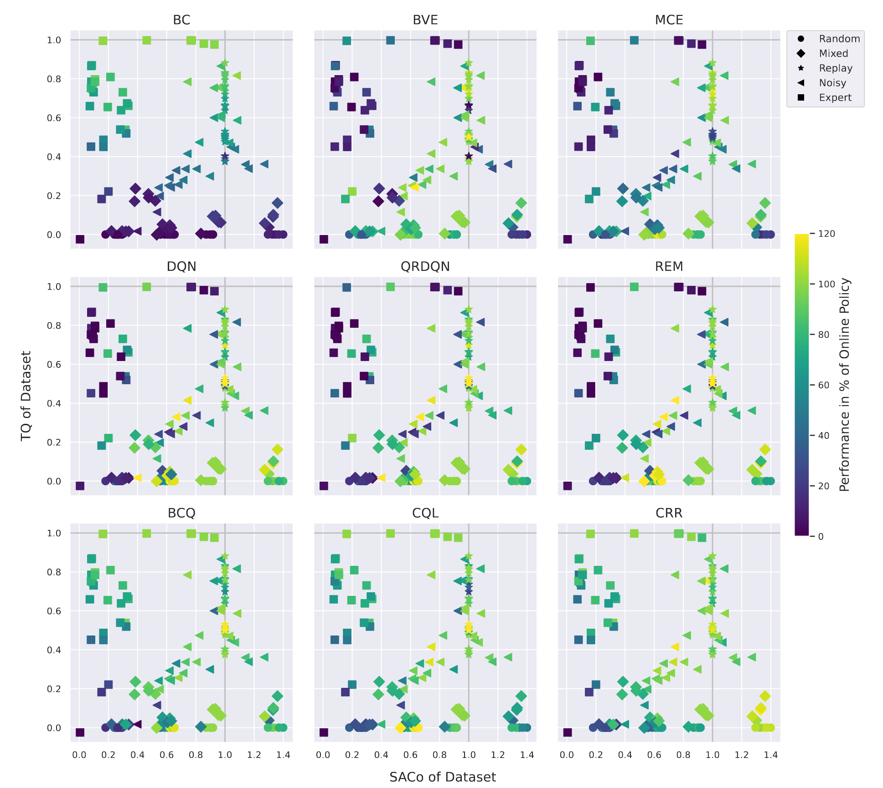
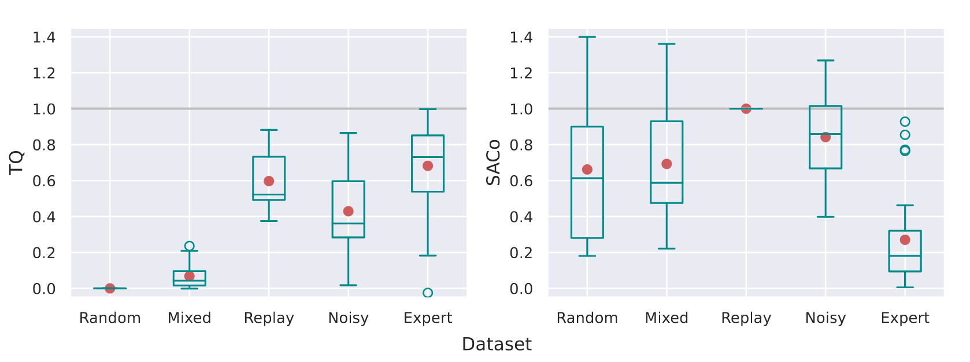
Dataset perspective
Define two metrics for dataset:
TQ: Exploitive behavior of dataset
SACo: Diversity of dataset, based on entropy
When to use which algorithm?
Schweighofer, K., Dinu, M. C., Radler, A., Hofmarcher, M., Patil, V. P., Bitto-Nemling, A., ... & Hochreiter, S. (2022). A dataset perspective on offline reinforcement learning. In Conference on Lifelong Learning Agents.

Slide 24
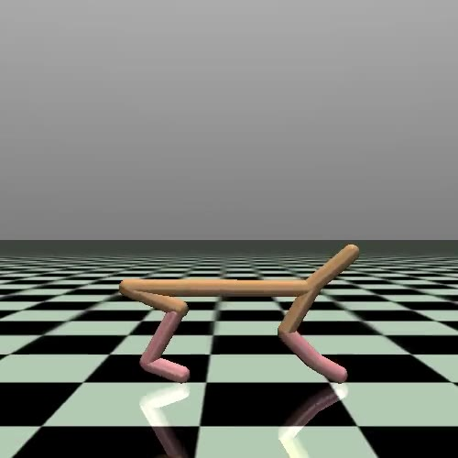
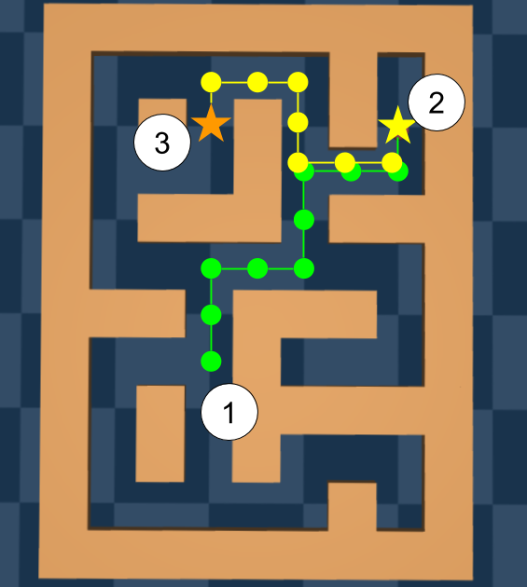
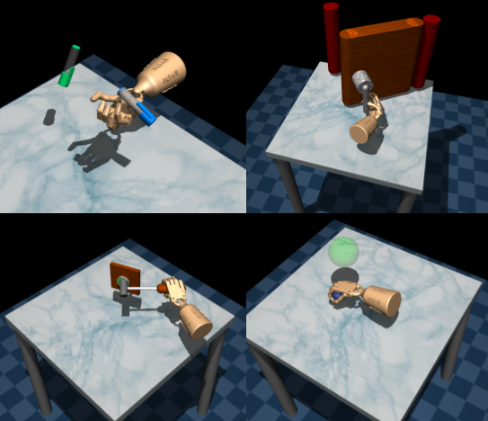
Datasets and Benchmarks
D4RL Benchmark (Mujoco Tasks)
Random, Medium, Replay, Expert, and mixtures
Collected by training online RL Agent
NeoRL
Learning from conservative and limited data
D4RL is too much exploratory (not realistic)
Comparing with the working policy
More application including industrial process, finance
Fu, J., Kumar, A., Nachum, O., Tucker, G., & Levine, S. (2020). D4rl: Datasets for deep data-driven reinforcement learning.
Qin, R. J., Zhang, X., Gao, S., Chen, X. H., Li, Z., Zhang, W., & Yu, Y. (2022). NeoRL: A near real-world benchmark for offline reinforcement learning, NeurIPS

Slide 25
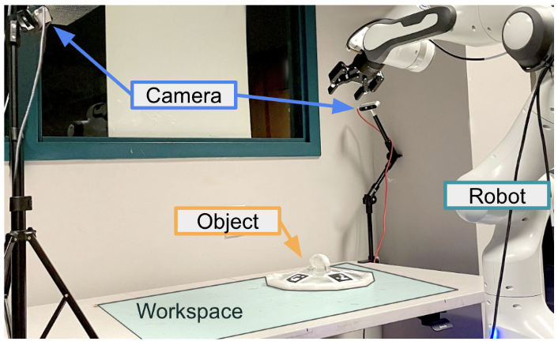
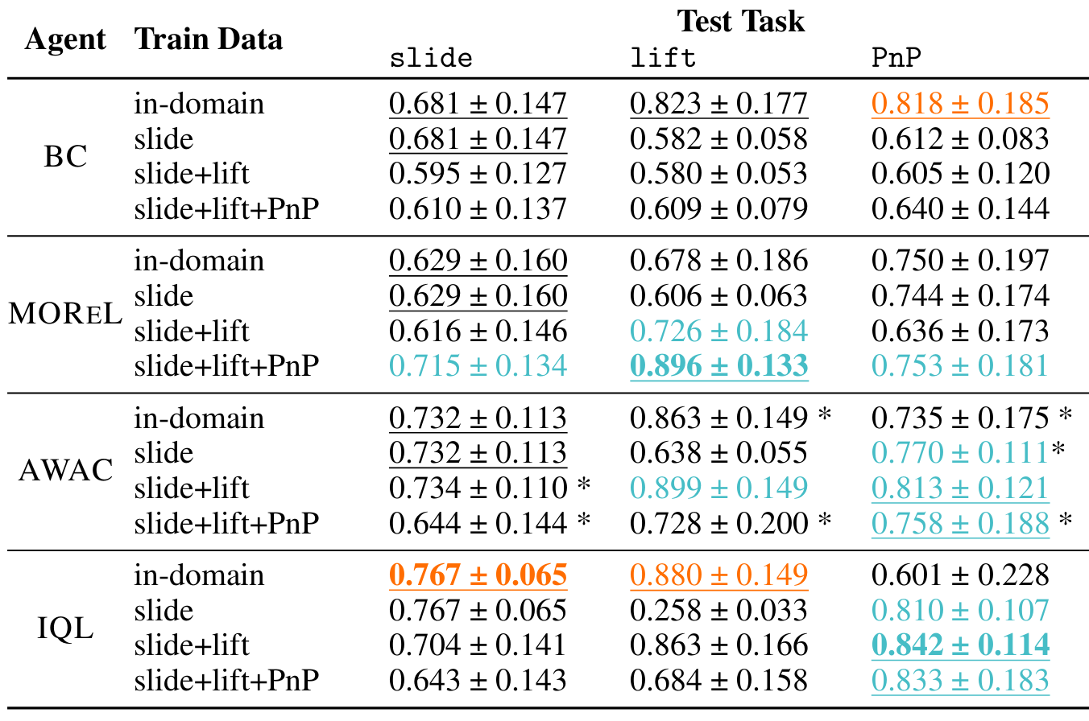
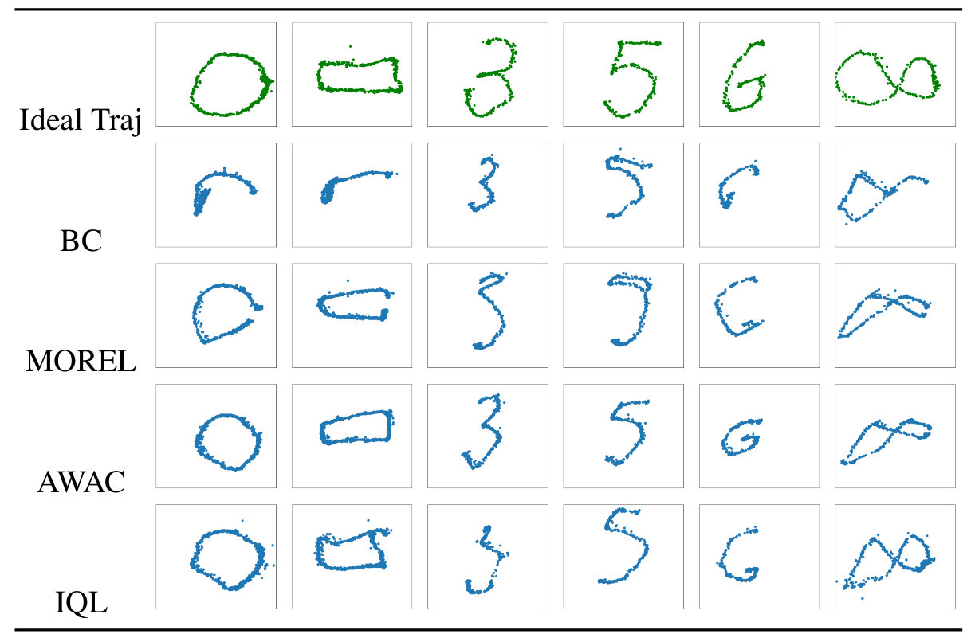
Realistic Offline RL
Used practical real-world data:
6500 trajectories over 800 robot hours
Hardware noise and delays
Can combination of datasets be beneficial?
Zhou, G., Ke, L., Srinivasa, S., Gupta, A., Rajeswaran, A., & Kumar, V. (2023). Real world offline reinforcement learning with realistic data source. ICRA

Slide 26
Offline Evaluation (Model Selection)
How to make sure learned policy is good?
There is no general, reliable offline method!
Using real world:
Accurate, but can be expensive/risky, not completely offline!
Simulators
Might be helpful for comparing policies, but building a good simulator can be hard
Heuristics
Easy and cheap, but not reliable and general purpose

Slide 27
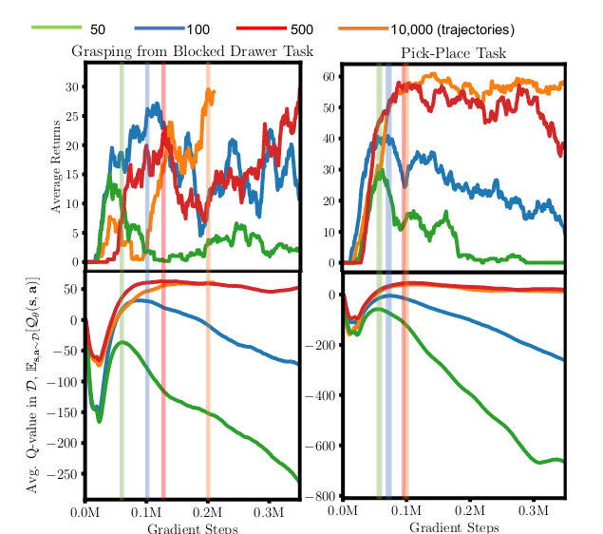
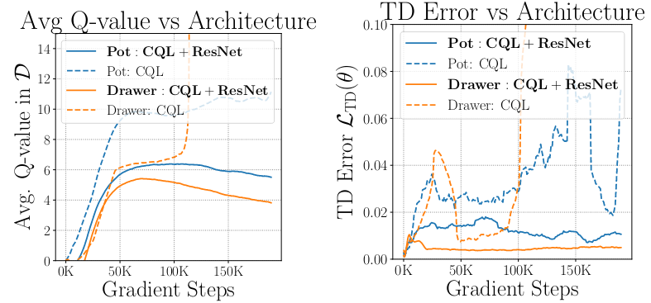
Workflow for conservative Offline RL
Provide metrics and condition for overfitting and underfitting in CQL
Overfitting:
Expected average Q values of dataset decreasing after increasing, also low value
Add capacity decreasing regularizer (VIB)
Underfitting:
High values in TD errors, compare with higher capacity model (regularizer), if TD errors decrease significantly, underfitting
Add capacity decreasing regularizer (DR3)
Larger models (ResNet)
Kumar, A., Singh, A., Tian, S., Finn, C., & Levine, S. (2022). A workflow for offline model-free robotic reinforcement learning, CoRL

Slide 28


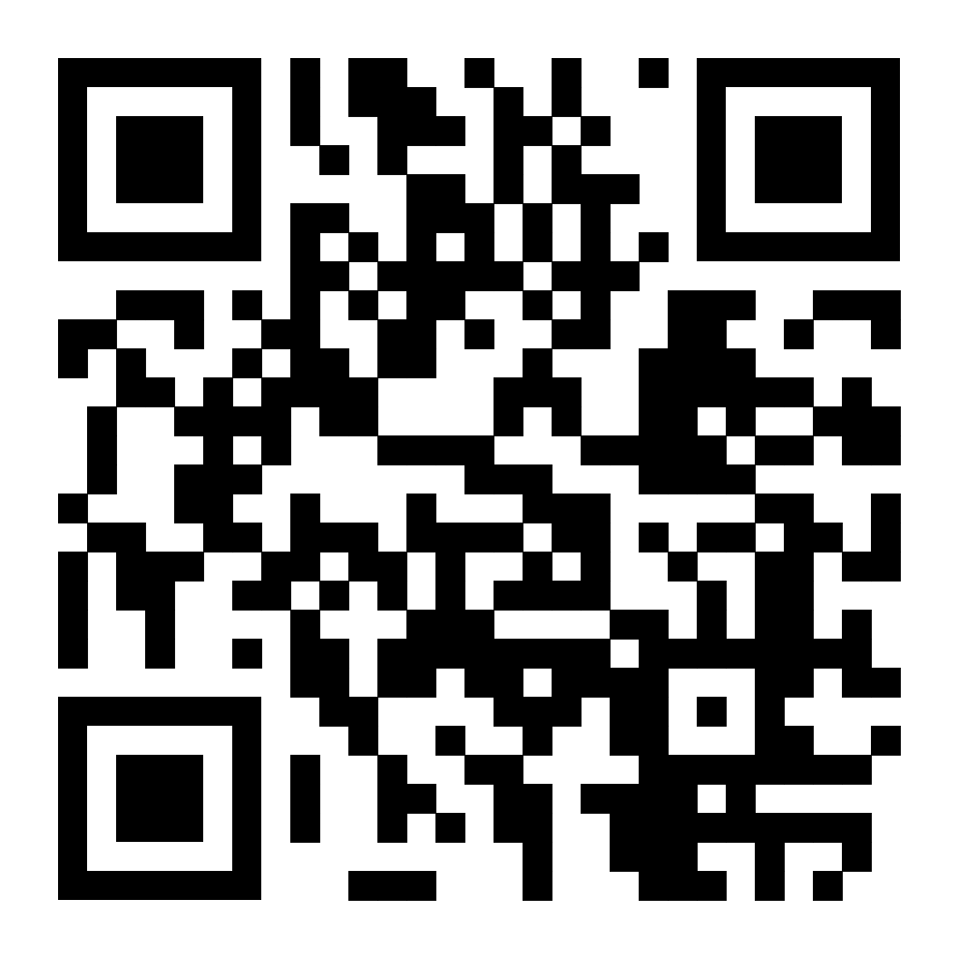

Take Away from Today
Difference between offline and online RL
Importance of offline RL
Distribution shift
The basic idea behind some methods
Some of the current limitation of offline RL

